Slide 1

CORE PROJECT ON “CALENDAR APPLICATION”
Made By -
Ishwari Gangadhar
Under the Guidance -
Ameena Farooqui

Slide 2
INTRODUCTION
The Calendar Application project provides a basic tool for managing and visualizing events on a calendar. The application supports features such as viewing monthly calendars, adding, viewing, and deleting events, using a command-line interface.

Slide 3
OBJECTIVE
Display a monthly calendar for a specified year and month.
Allow users to add, view, and delete events on specific dates.
Provide a command-line interface for user interaction.
Develop a simple and intuitive interface that allows users to navigate through months and years effortlessly.
Ensure the interface is visually appealing and easy to use for people of all tech-savviness levels.

Slide 4
BACKGROUND
Calendars are essential tools for managing time and events. This project leverages Python's calendar and datetime modules to build a basic calendar application. The functionality includes viewing a monthly calendar, managing events, and interacting with users through a console-based interface.Similar to widely used applications like Google Calendar and Microsoft Outlook, the design aimed to combine simplicity with powerful functionality.

Slide 5
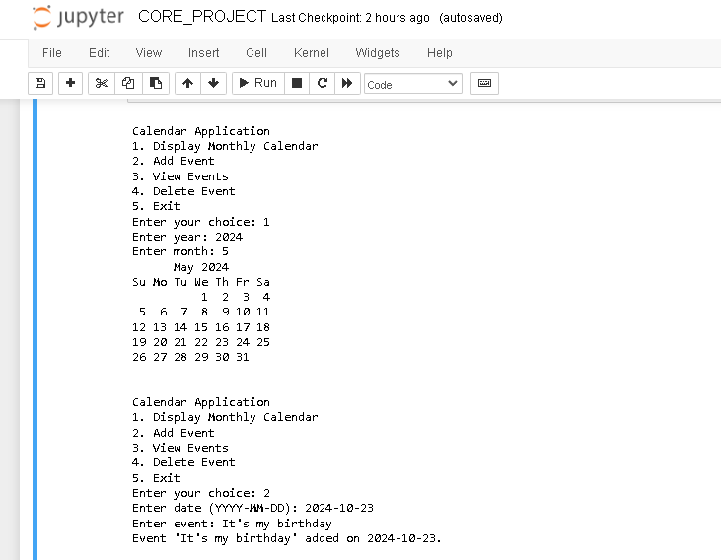
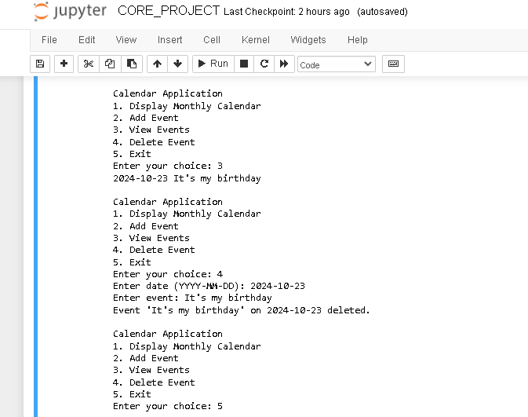
OUTPUT SCREENSHOT

Slide 6
FUTURE SCOPE
Implementing a graphical user interface (GUI) using libraries such as Tkinter
Adding functionality for recurring events and reminders.
Integrating with external APIs to synchronize with online calendars.
Adding a search feature to find events by keyword or date.

Slide 7
CONCLUSION
The Calendar Application effectively demonstrates basic calendar operations and event management using Python. It provides a useful tool for managing personal schedules and showcases fundamental programming concepts, including user interaction, date manipulation, and data storage. The project aimed to build a functional tool that displays the current month, allows navigation between months, and marks specific dates. We successfully implemented these features, showcasing the efficiency of Python for creating practical applications.

Slide 8
REFERENCES AND BIBLIOGRAPHY
https://docs.python.org/3/
https://docs.python.org/3/library/calendar.html
https://docs.python.org/3/library/datetime.html

Slide 9
THANK YOU

